Slide 1
ESP32-CAM WebSocket Controlled Robot Car with Pan-Tilt Camera
Third Year Mini Project – Electrical Engineering
By
Ali Akar

Slide 2
Introduction
Developed a smart robot car capable of wireless control using WebSocket communication.
The robot is equipped with an ESP32-CAM module for live video streaming and serial communication.
Along with pan-tilt servos for camera movement.

Slide 3
Use Case
Access areas where humans can’t reach.
Real-time video helps monitor rooms from anywhere in the house.
Remote item retrieval for elderly or mobility-impaired users.
Security or Alarm System Extension.
Playful tool for children.
Mobile Camera Bot for Content Creation.

Slide 4
Components Used
4WD Car Chassis
Pan-Tilt Servo Support
Esp32 Cam Module
L298N Motor Driver
LM2596 Buck Converter
SG90 Servo Motor/Pan
MG90 Servo Moto/Tilt
2x18650 Battery pack holder for car motors)
4xAA Battery pack holder/7v for servos
Male to female jumper wires
Female to female jumper wires
Flux tape
Glue Gun

Slide 5
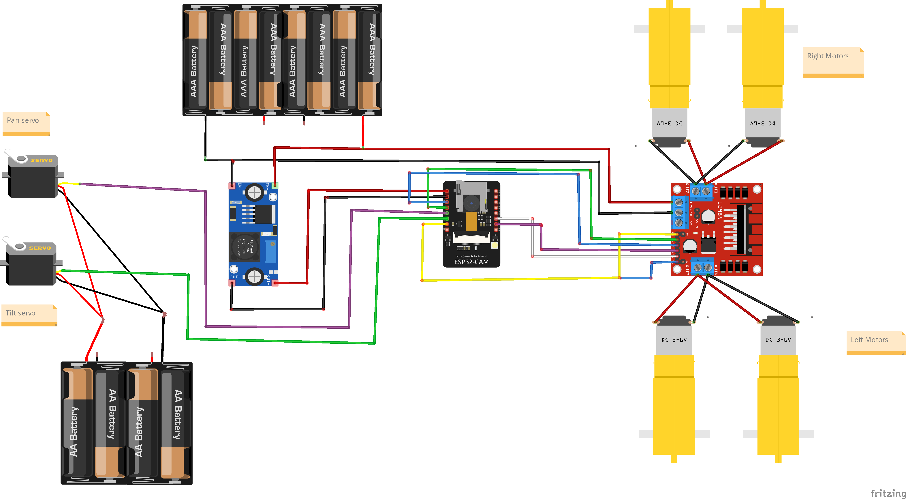
Wirings

Slide 6
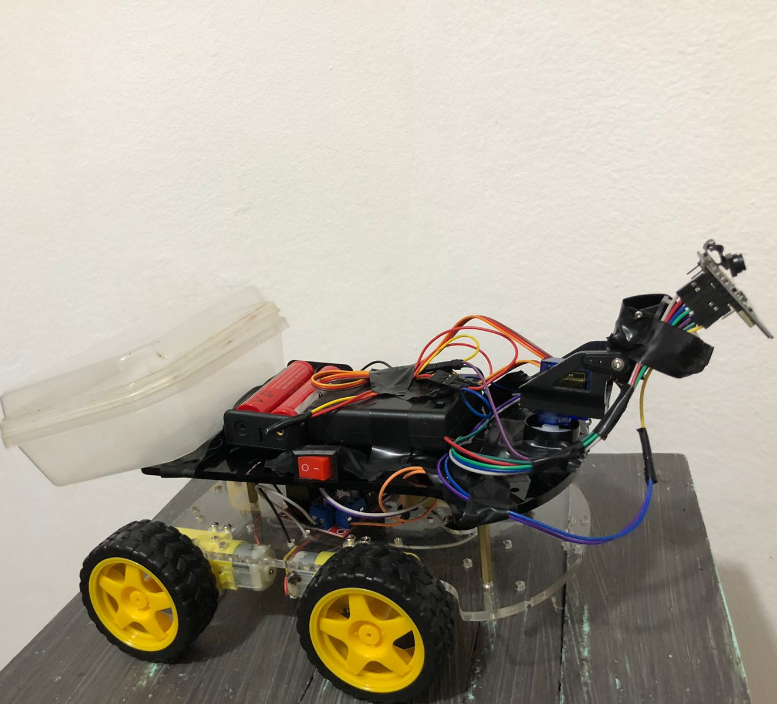
Final Look
Here’s the finished robot car! Everything’s wired up and working — live camera, motor controls, and servos all running smoothly through WebSocket. Ready to roll!

Slide 7
Challenges Faced
Problems
Fixes
Power management for motors and servos.
ESP32 overheating.
Serial sync between ESP32 and Arduino.
Servo Jitter
Wi-Fi reliability in different locations.
Assign different batteries
Wire Esp32 via buck converter
Used Esp32 only
Use MG90 Servo
Can use external antenna for wide region covers

Slide 8
Conclusion
This project highlights the power of combining creativity with technology to solve real-world challenges. It reflects the value of hands-on learning, problem-solving, and continuous improvement. Beyond the technical outcomes, it serves as a reminder that even small steps in innovation can lead to meaningful progress and open the door to bigger ideas in the future.

Slide 9
Thank you/Q&A
Thank you for your attention.
Open to any questions or feedbacks

